Slide 1
AWS Step Functions
Lecturer: Ngo Huy Bien
Software Engineering Department
Faculty of Information Technology
University of Science
Ho Chi Minh City, Vietnam
nhbien@fit.hcmus.edu.vn

Slide 2

Objectives

Slide 3

Contents

Slide 4

References

Slide 5
AWS Step Functions
https://aws.amazon.com/step-functions/
AWS Step Functions is a visual workflow service that helps developers use AWS services to build distributed applications, automate processes, orchestrate microservices, and create data and machine learning (ML) pipelines.

Slide 6
Why AWS Step Functions?
Ensure that multiple long-running ETL jobs run in order and complete successfully, without the need for manual orchestration.
Iterate over and process large data-sets such as security logs, transaction data, or image and video files.
Combine multiple AWS Lambda functions into responsive serverless applications and microservices.
Create automated workflows, including manual approval steps, for security incident response.

Slide 7
State Machines
With AWS Step Functions, you design your workflow as a state machine.
State machines are defined with Amazon States Language in a JSON format.
A state machine contains multiple states. Here’s a review of the different states:
Task: Performs some work.
Choice: Makes a decision for the next branch of execution.
Succeed or Fail: Ends the execution.
Pass: Passes input to output.
Parallel: Creates multiple branches of execution.
Map: Runs tasks in parallel on the items in a dataset.

Slide 8
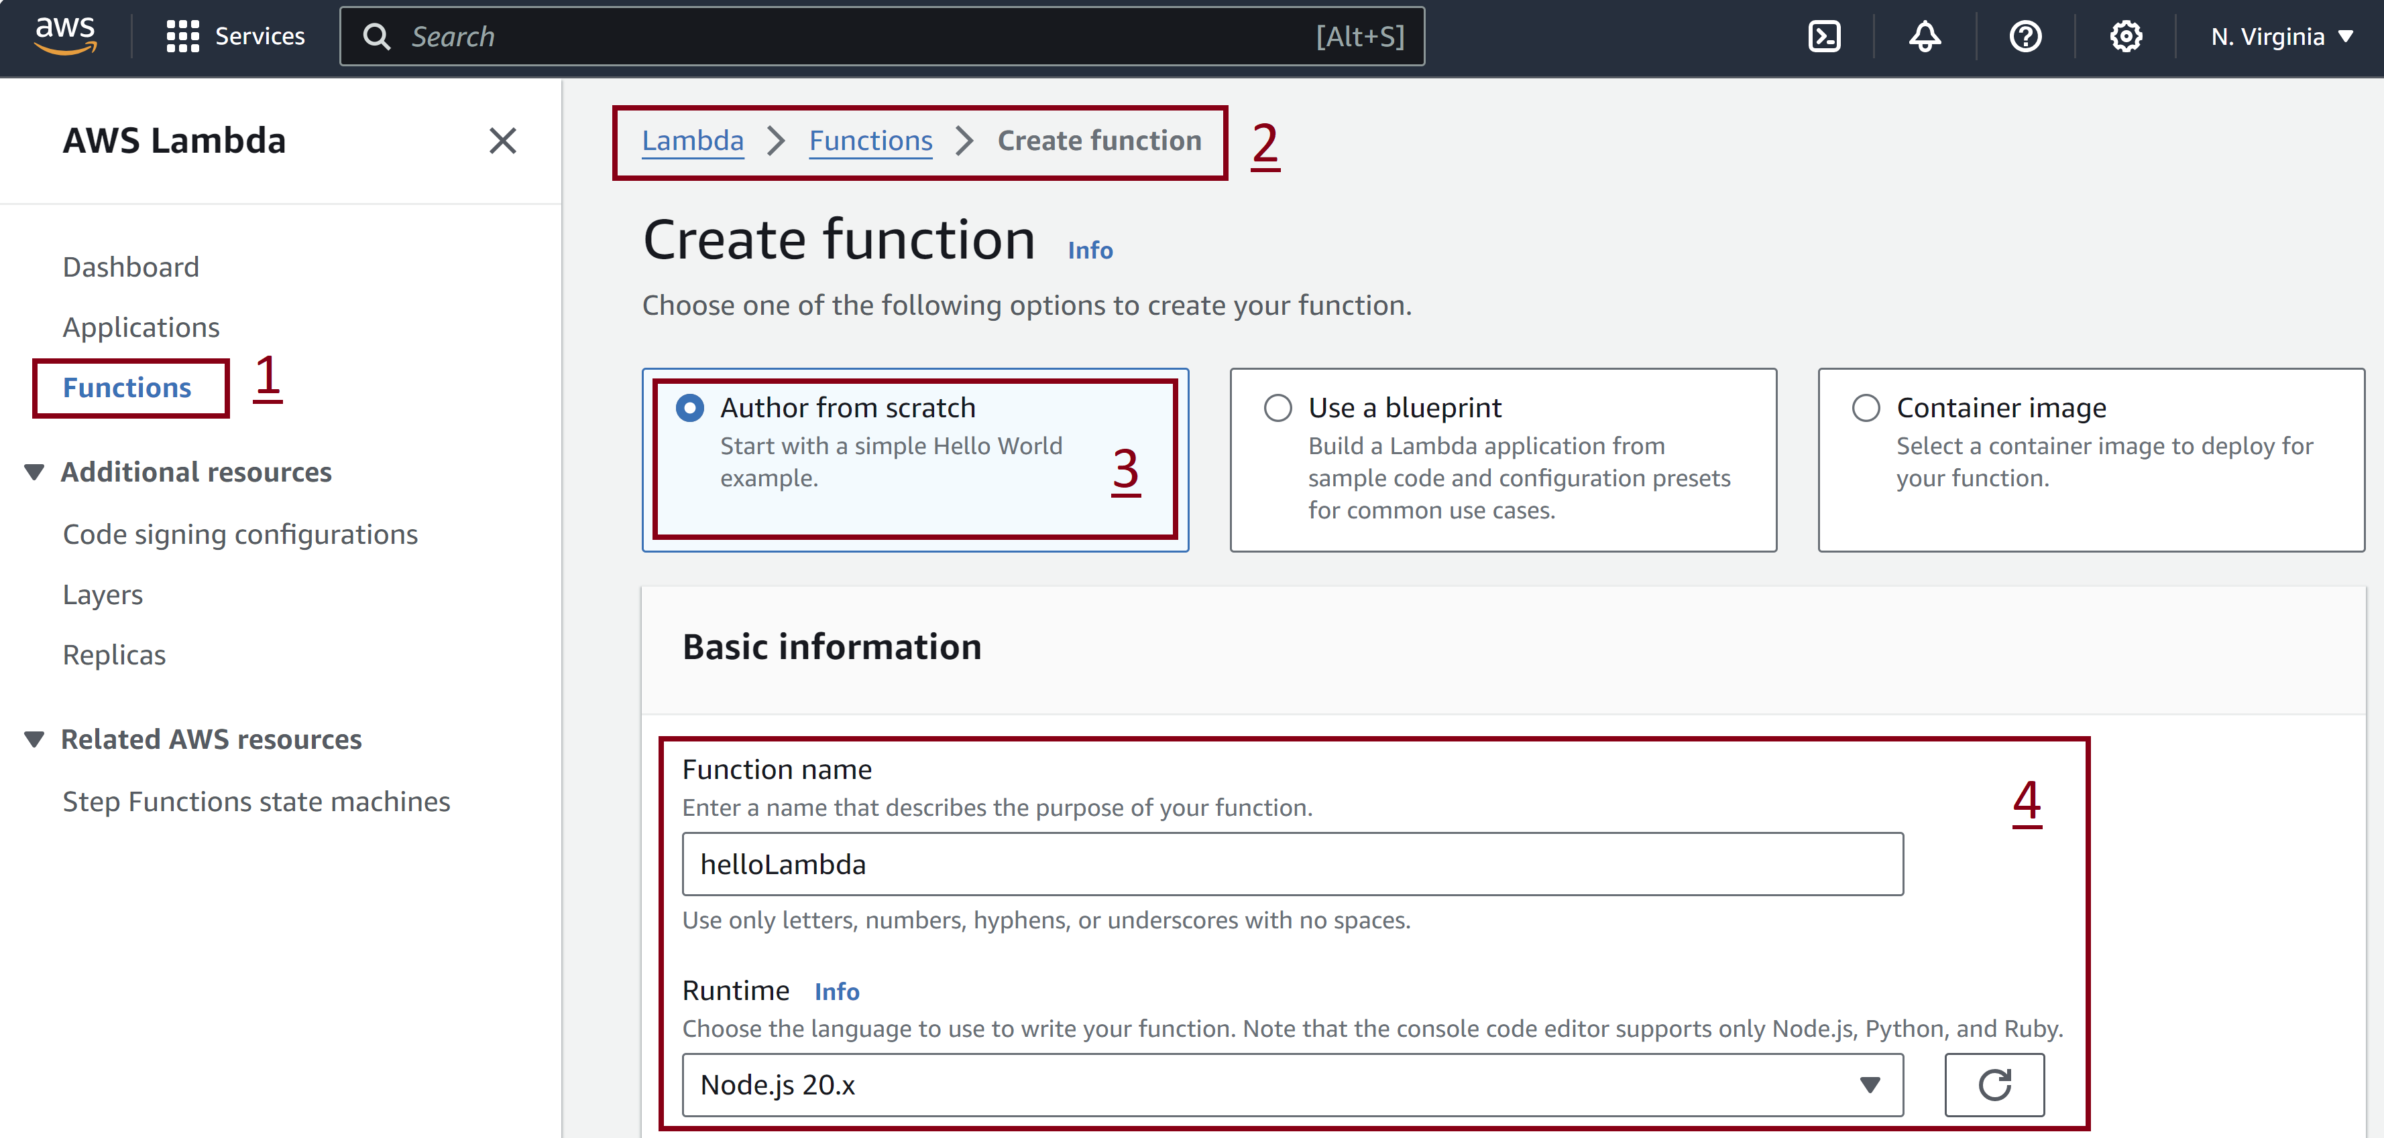
1. Create Lambda Function

Slide 9
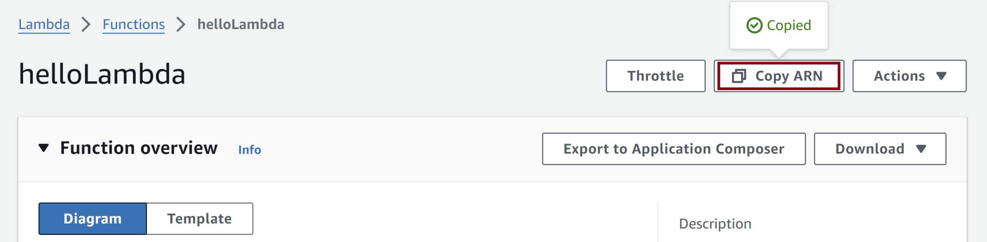
2. Copy ARN
arn:aws:lambda:us-east-1:135319629286:function:helloLambda

Slide 10
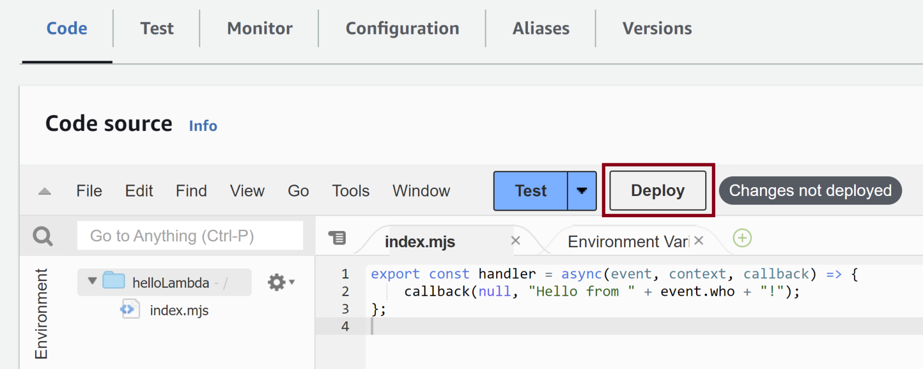
3. Enter Code and Deploy
export const handler = async(event, context, callback) => {
callback(null, "Hello from " + event.who + "!");
};

Slide 11
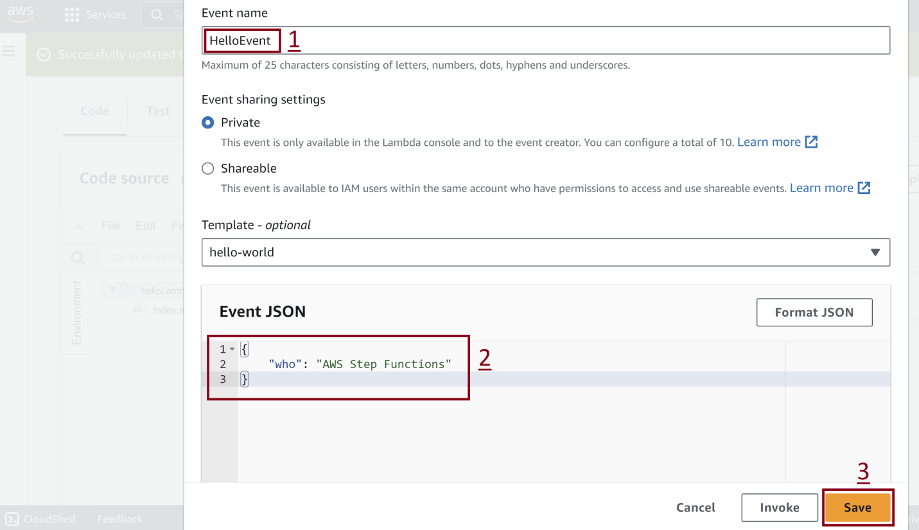
4. Test the Lambda Function
{
"who": "AWS Step Functions"
}

Slide 12
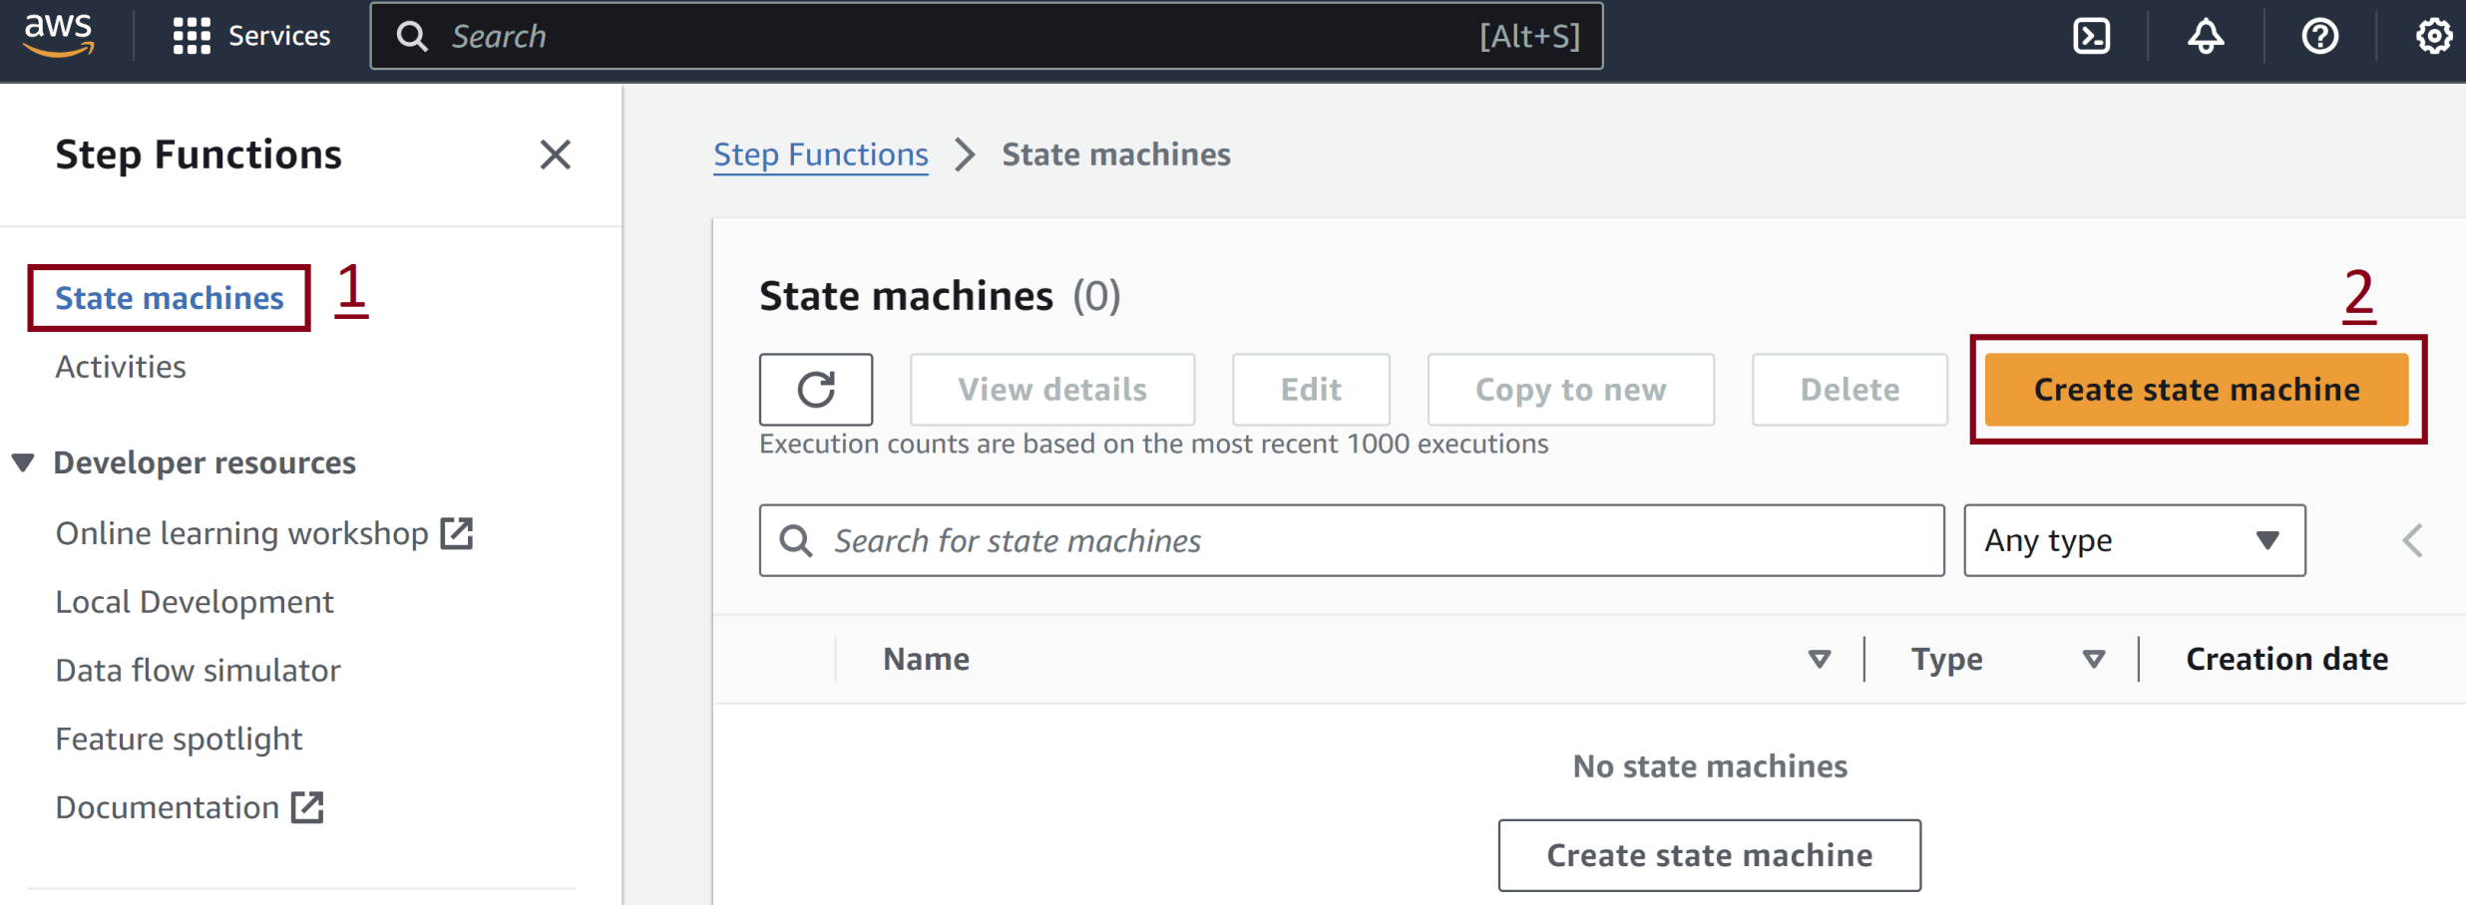
5. Create State Machine

Slide 13
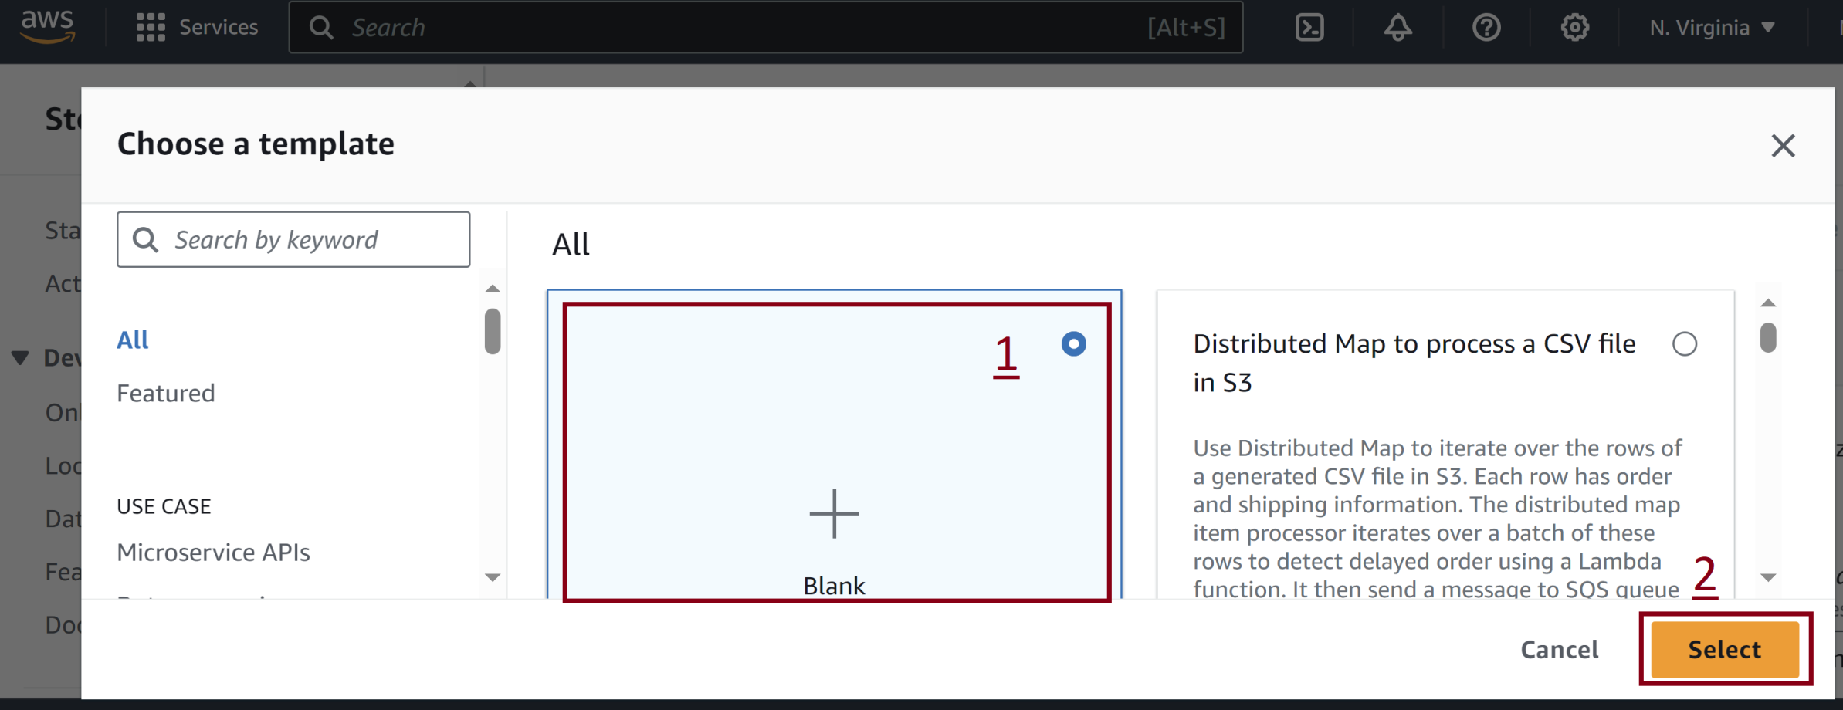
6. Select Blank Template

Slide 14
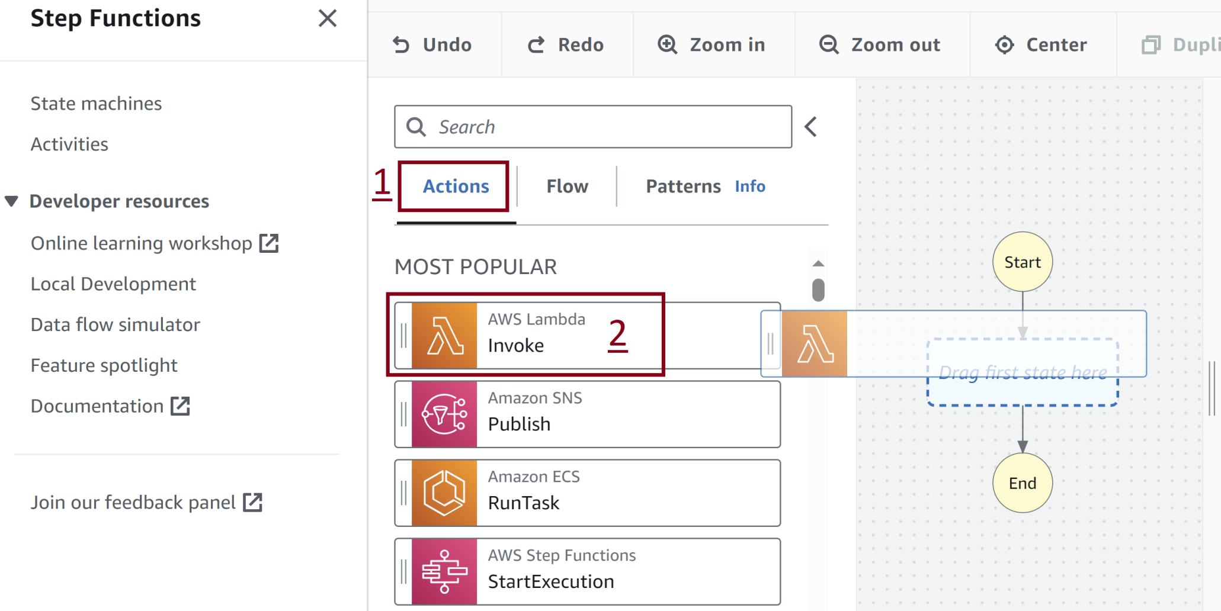
6. Select Blank Template

Slide 15
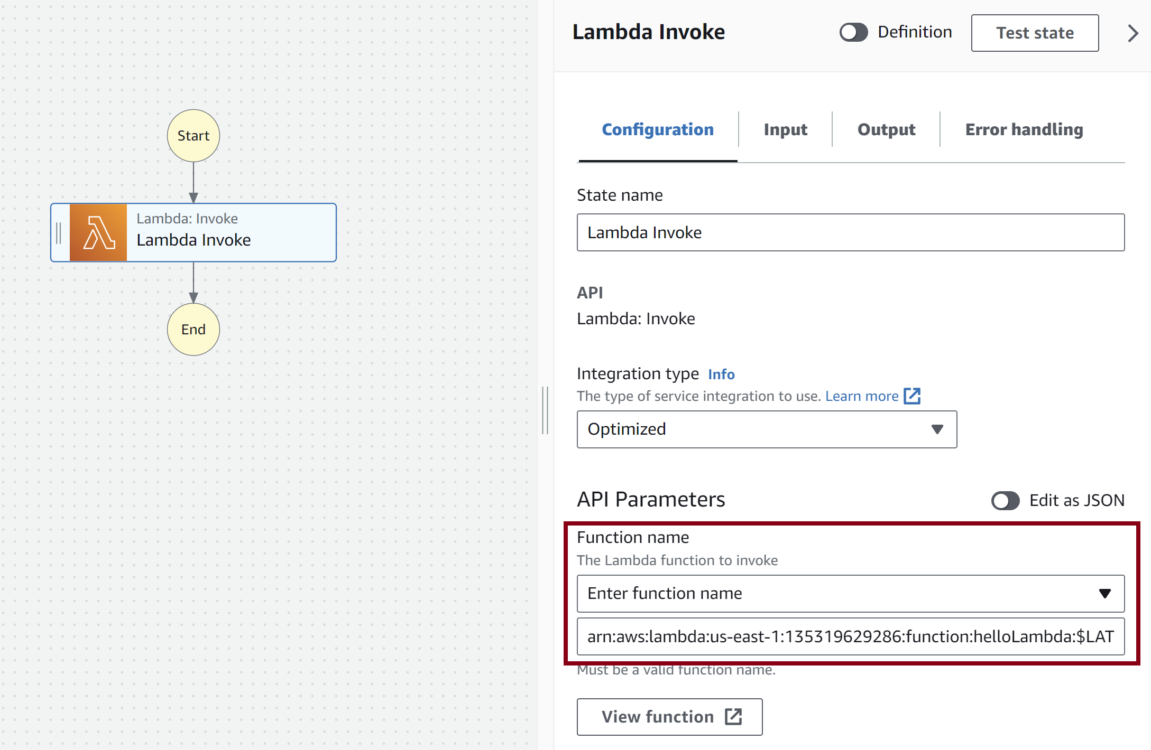
7. Select Lambda Function

Slide 16
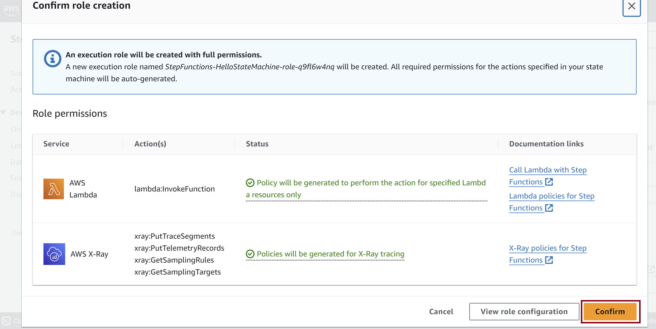
8. Confirm Role Creation

Slide 17
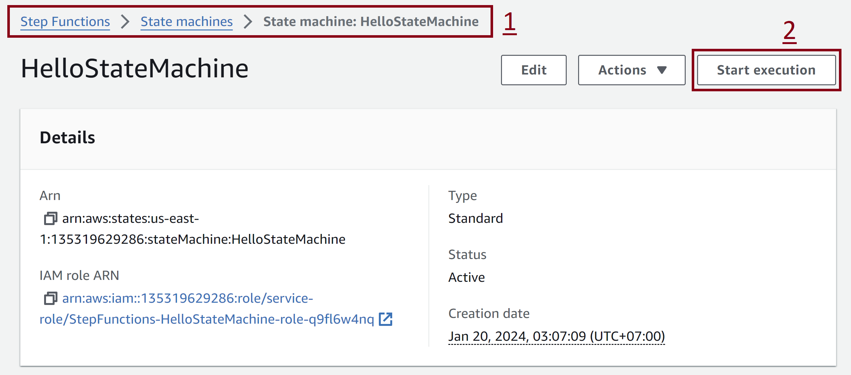
9. Run State Machine

Slide 18
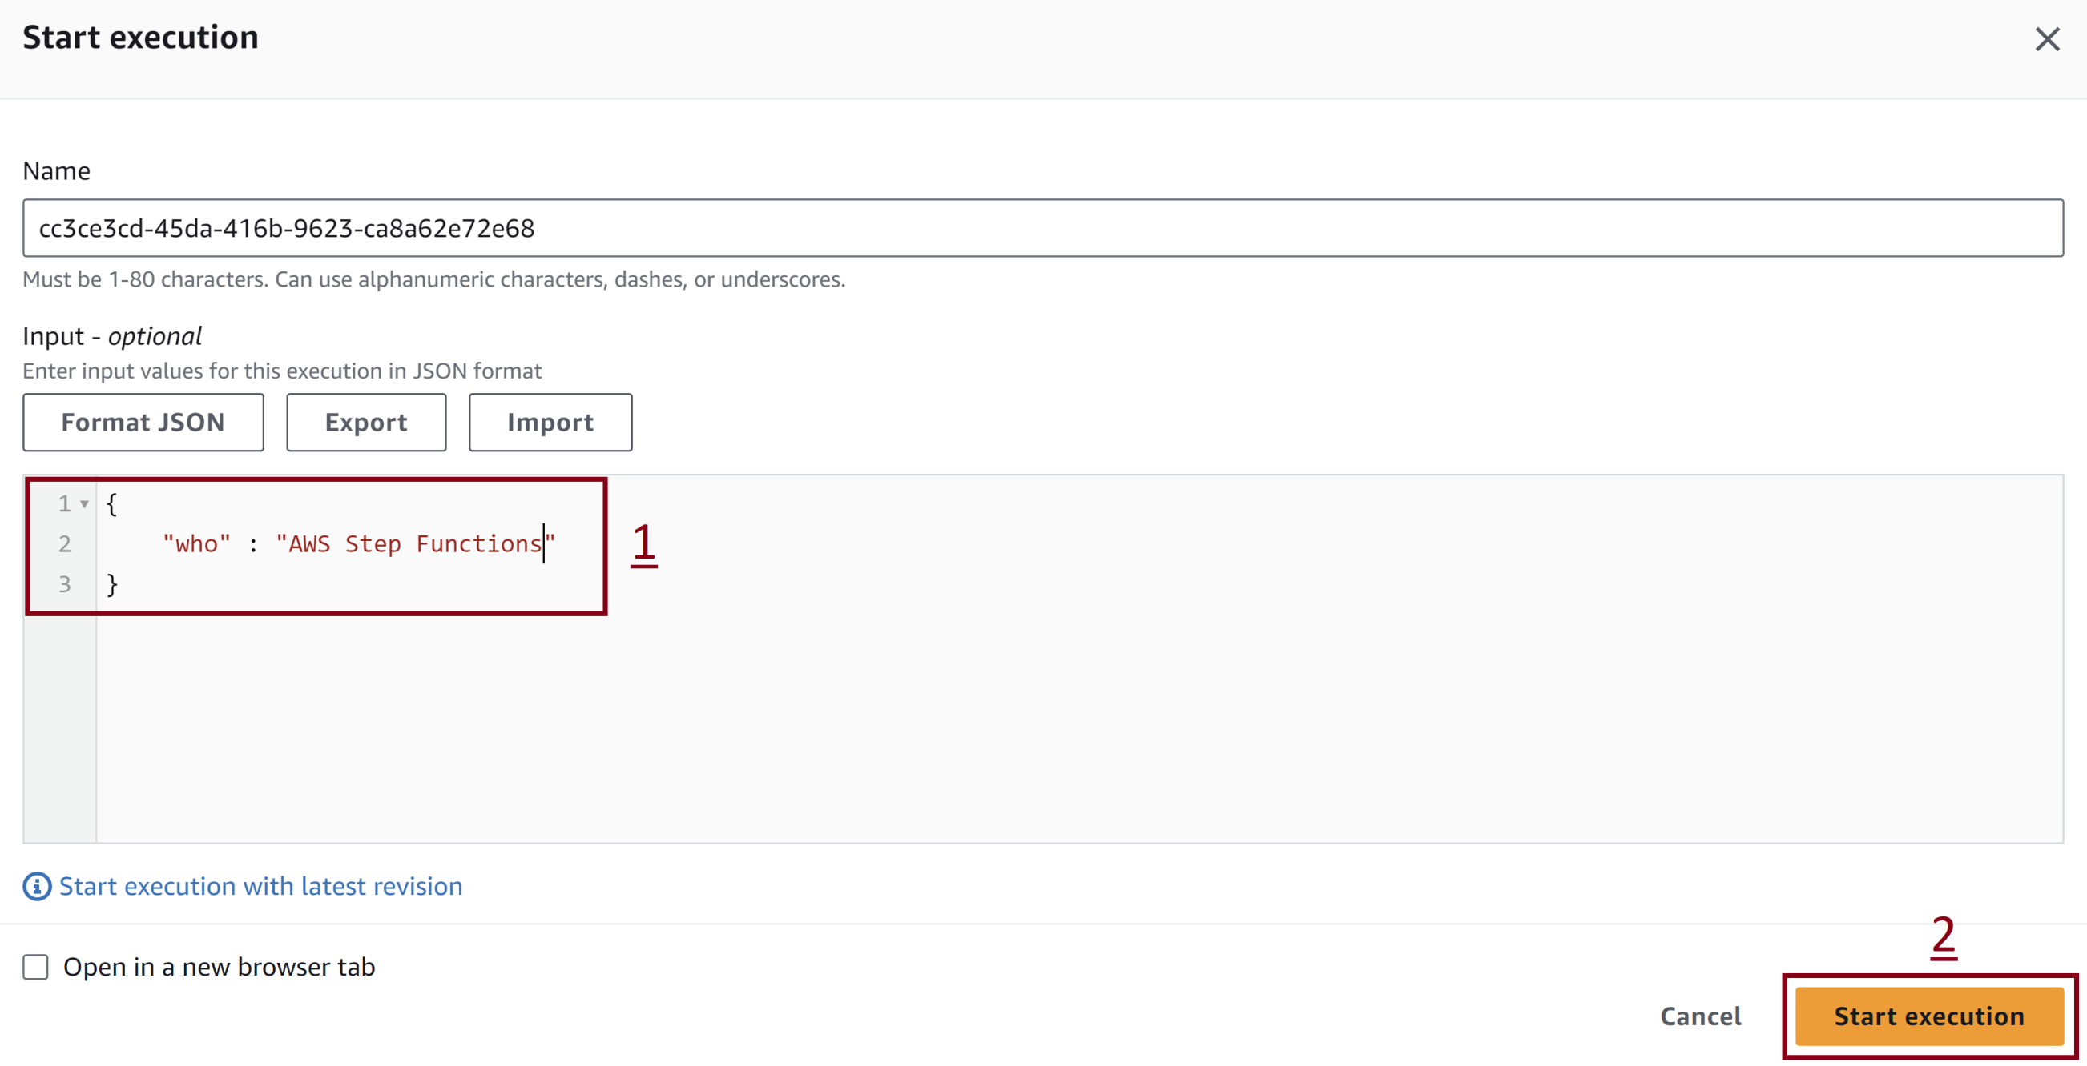
10. Start Execution
{
"who": "AWS Step Functions"
}

Slide 19
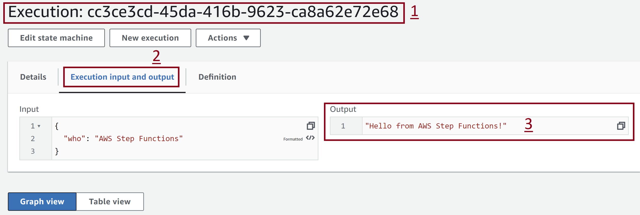
11. Review Output

Slide 20
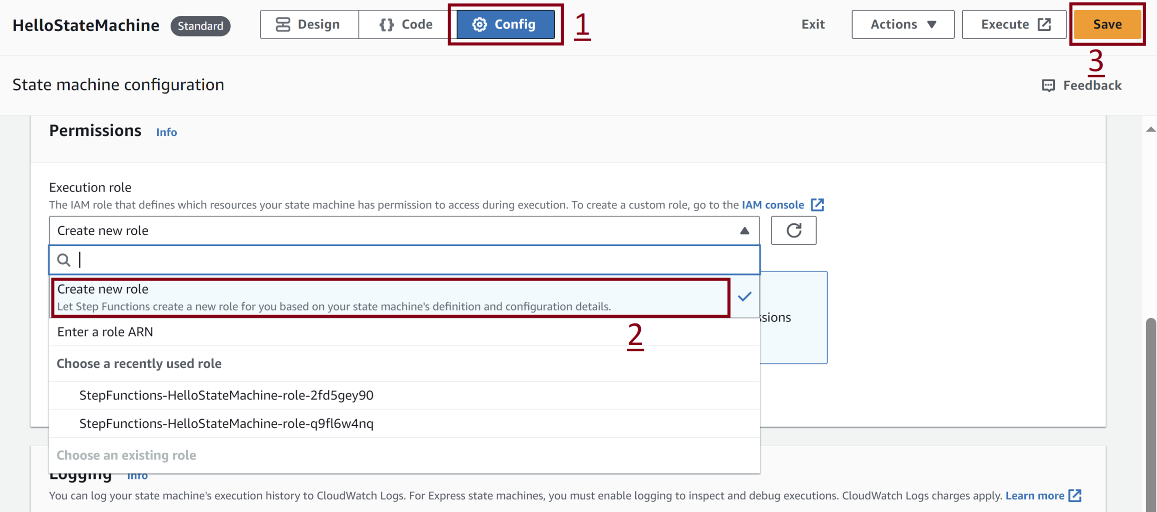
13. Modify Execution Permissions

Slide 21

Thank You & See You Again

